Slide 1

Power BI Final Project
Data
Analyst

Slide 2


YellowTrip Data Analysis
May & June 2020 — New York City
VENDORS
EMPLOYEES
DATA :
Income
Returns
Vehicle types
Pickup locations
Rush hours
Vendors
OBJECTIVES:
Analyze:
Performance
Trends
Trips and trip distance
Overall statistical approach
DATA :
Income
Tips
Boroughs
Vehicle types
Distance traveled
Passengers
OBJECTIVES:
Analyze:
Tips
Average income
Overall statistical approach

Slide 3

Business Questions
Vendor perspective
What is the distribution of vehicle types by day of the week?
Which five hours a day, on average, have the most starting times for rides?
Where are generated more trips? (pickup boroughs perspective)

Slide 4
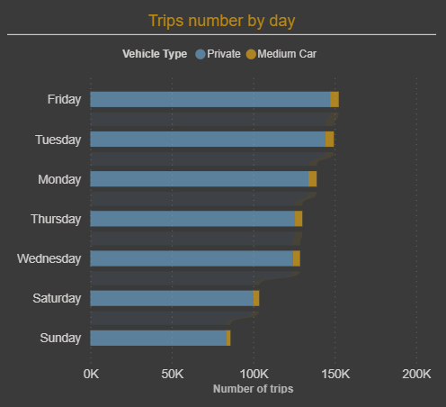
What is the distribution of vehicle types by day of the week?
Friday - most trips on average
Private vehicle - most chosen one
Notes:
As Vendor, it indicates that we should focus on buying cars for the private service and dive deeper to understand why the other types of car aren´t chosen as much

Slide 5
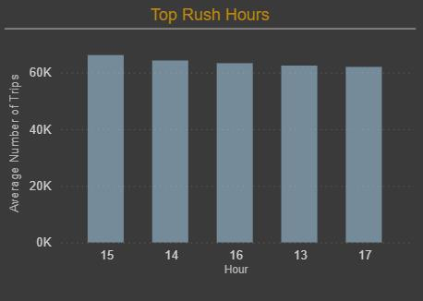
Which five hours a day, on average, have the most starting times for rides?
1st - 15:00
2nd - 14:00
3rd - 16:00
Notes:
As Vendors this times of the day are our priority

Slide 6
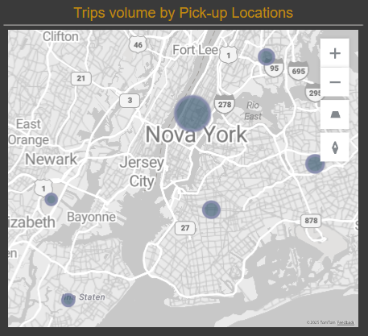
Bronx 21.825
Which pickup boroughs generate the most trips?
Manhattan 775.326
Brooklyn 37.116
EWR – International Airport Newark 38
Queens 54.457
Staten Island 884
Unknown 8.417
Notes:
This is telling us that as a vendor we want to have as many cars available at this locations as possible especially during peak times, we should proritize being in this location rather then everywhere else

Slide 7

Business Questions
Employee perspective
What are the two days a week when the average income per trip is the highest?
What is the type of vehicle with the highest tip per Km?
What are the best tipping boroughs?
Which boroughs have the highest number of passengers?

Slide 8
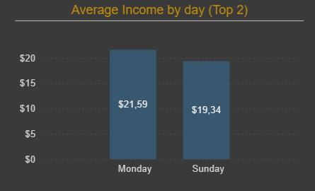
What are the two days a week when the average income per trip is the highest?
Average Income per trip
$ 19,12
Notes:
Those days needs to be our “ focous days” to make money, as a employee we want to be working as much as possible during these days, not taking days off or doing any car maintenence

Slide 9
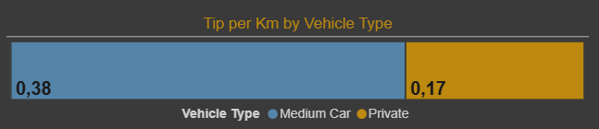
What is the type of vehicle with the highest tip per Km ?
Notes:
It indicates that as an employee driving a Medium vehicle might be more profitable comparing to driving a private one, depending on the length of the trips, but requires further analysis to be sure

Slide 10
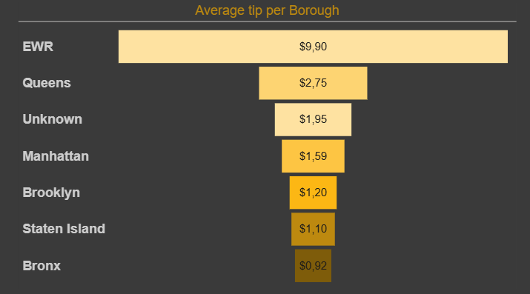
What are the best tipping boroughs?
Notes:
As a employee, these are the best two locations because the chances that the driver takes more money home are higher compared to other boroughts

Slide 11
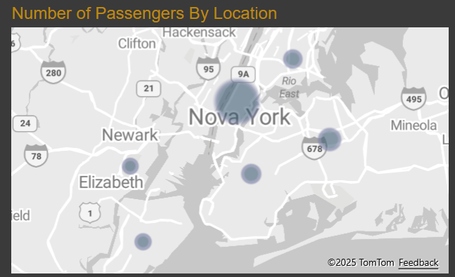
Which boroughs have the highest number of passengers?
Bronx 8.025
Brooklyn 13.920
Manhattan 973.316
EWR – International Airport Newark 64
Queens 51.956
Staten Island 206
Unknown 9.670

Slide 12
Conclusions
High number of trips - Friday
Rush hours - between 13h and 17h (15h as peak hour)
Top 3 boroughs - Manhatan, Queens and Brooklyn (Nº of passengers | trips)
Prefered vehicle type - Private
Highest trip number vendor – VeriFone Inc.

Slide 13
Suggestions
Focous on Manhatan, Queens and Brooklyn
Verify the unknown boroughs (LocationID 264 and 265)
NewPlayer - Focous on night shift and without medium car
VeriFone Inc. – Review the high number of returns

Slide 14
Q&A

